Slide 1
OLIGOPOLY

Slide 2
WHAT IS OLIGOPOLY?
Another market type that stands between perfect competition and monopoly.
Oligopoly is a market type in which (characteristics):
A small number of big firms compete/ sellers.
Interdependence of decision making
Barriers to entry
Product may be homogeneous or there may be product differentiation
Indeterminate price and output

Slide 3
Oligopoly Models
OLIGOPOLIST MODELS
1.Non collusive model
Cournot model
Edgeworth model
Bertrand model
Stackelberg model
Sweezy’s model
2.Collusive Model
Cartels
Low cost price leader
Market dominant price leader
Barometric price leader

Slide 4
Collusive oligopoly Model
Temptation to Collude
When a small number of firms share a market, they can increase their profit by forming a cartel and acting like a monopoly.
A cartel is a group of firms acting together to limit output, raise price, and increase economic profit.
(Eg. OPEC)
Cartels are illegal but they do operate in some markets.
Despite the temptation to collude, cartels tend to collapse. (We will explain why in the final section.)

Slide 5
Cartel is formed with the view :
To eliminate uncertainty surrounding the market
Restraining competition and thereby ensuring gains to cartel group
Cartel works through a Board of Control, board determines the market share to each of its members.

Slide 6
Reasons why industry profits may not be maximized
Mistakes in estimation of market demand
Mistakes in estimation of marginal cost
Slow process of cartel negotiation
Stickiness of negotiated price
Fear of government interference
Fear of entry

Slide 7
Price Leadership model
Dominant Firm Price Leadership
Price Leadership by low cost firm
Barometric Price Leadership

Slide 8
Dominant Firm Price Leadership
There is a large dominant firm which has a considerable share of total market, and some small firms, each of them having a small market share.
The market demand is assumed known to dominant firm
It is also assumed that the dominant firm knows the MC curves of the small firms.

Slide 9
Dominant Firm Price Leadership
At each price dominant firm will be able to supply the section of total market not supplied by small firm.
The dominant firm maximizes his profit by equating MC and MR, while the small firms are price takers, and may or may not maximize their profit, depending on their cost structure.

Slide 10
Why Would Firms - Behave this Way?
Only one firm may be large enough to set prices.
Alternatively, it may be in their best interest to do this.

Slide 11
Price Leadership by low cost firm
Assumptions:
Suppose all the firms face identical revenue curves shown by AR and MR
But they have different cost curves.

Slide 12
Barometric Firm Price Leadership
Barometric Firm is a firm supposed to have a better knowledge of the prevailing market conditions and has an ability to predict the market conditions more precisely than any of its competitors.
Usually it is the firm which from past behavior has established the reputation of good forecaster of economic changes.
Other industries follow as they try to avoid the continuous recalculation of costs, as economic condition changes.

Slide 13
Kinked Demand Model
Model developed by P Sweezy
In this model, it is assumed that the firm is afraid to change its price.
It is a tool which explains the stickiness of prices in oligopolistic markets, but not as a tool for determination of prices itself.

Slide 14
Kink reflects the following behaviour :
If entrepreneur reduces his price he expects that his competitor would follow, matching the price cut, so that although the demand in the market increases, the share of competitor remains unchanged.
However the entrepreneur expects that his competitors will not follow him if he increases his price, so that he will lose a considerable part of his customer.

Slide 15
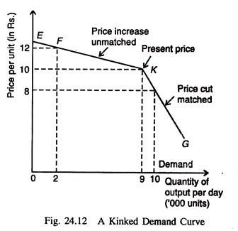
Kinked Demand curve

Slide 16
Criticism of kinked demand model
It does not explain the price and output decision of the firm.
It does not define the level at which the price will be set in order to maximise profits.
It does not explain the level of price at which kink will occur. It does not explain the height of the kink.
It is not the theory of pricing, rather a tool to explain why the price once determined will tend to remain fixed.

Slide 17
GAME THEORY
Introduction
Game theory is a branch of mathematical analysis developed to study decision making in conflict situations.
Situation in which players (participants) make strategic decisions that take into account each other’s actions and responses.
Uses an interdisciplinary approach-mathematics and economics.
Game theory was introduced by the great mathematician John von Neumann. He developed the field with the great mathematical economist, Oskar Morgenstern.

Slide 18
GAME THEORY
Game theory
The tool used to analyze strategic behavior—behavior that recognizes mutual interdependence and takes account of the expected behavior of others.

Slide 19
GAME THEORY
What Is a Game?
All games involve three features/Components
Strategies- Rules- Plan of action for playing a game
Payoffs- Value associated with a possible outcome.
Optimal Strategy- Strategy that maximizes a player’s expected payoff.

Slide 20
Assumptions in Game Theory
Each decision maker (called player) has available to him two or more well-specified choices or sequences of choices (called strategy).
Every possible combination of strategies available to the players leads to a well-defined end-state (win,loss,or draw) that terminates the game.
A specified payoff for each player is associated with each end-state.

Slide 21
Assumptions (continued)
Each decision maker has perfect knowledge of the game and of her opposition; that is, she knows in full detail the rules of the game as well as the payoffs of all other players.
All decision makers are rational; that is, each player , given two alternatives, will select the one that yields her the greater payoff.

Slide 22
Cooperative vs Non- cooperative Games
Co-operative game : Game in which participants can negotiate binding contracts that allow them to plan joint strategies.
Non-cooperative game : Game in which negotiation and enforcement of binding contracts are not possible.

Slide 23
PRISONERS’ DILEMMA
A game between two prisoners that shows why it is hard to cooperate, even when it would be beneficial to both players to do so.

Slide 24
GAME THEORY
The Prisoners’ Dilemma
Art and Bob been caught stealing a car: sentence is 2 years in jail.
Inspector wants to convict them of a big bank robbery: sentence is 10 years in jail.
Inspector has no evidence and to get the conviction, he makes the prisoners play a game.

Slide 25
GAME THEORY
Rules
Players cannot communicate with one another.
If both confess to the larger crime, each will receive a sentence of 3 years for both crimes.
If one confesses and the accomplice does not, the one who confesses will receive a sentence of 1 year, while the accomplice receives a 10-year sentence.
If neither confesses, both receive a 2-year sentence.

Slide 26
GAME THEORY
Strategies
The strategies of a game are all the possible outcomes of each player.
The strategies in the prisoners’ dilemma are:
Confess to the bank robbery
Deny the bank robbery

Slide 27
GAME THEORY
Payoffs
Four outcomes:
Both confess.
Both deny.
Art confesses and Bob denies.
Bob confesses and Art denies.
A payoff matrix is a table that shows the payoffs for every possible action by each player given every possible action by the other player.

Slide 28
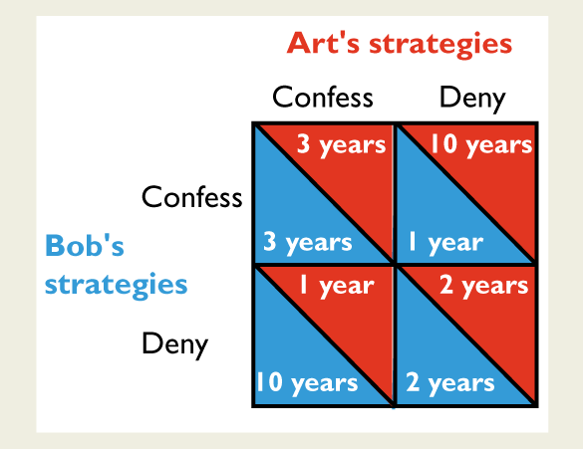
GAME THEORY
Table shows the prisoners’ dilemma payoff matrix for Art and Bob.

Slide 29
GAME THEORY
Collusion is Profitable but Difficult to Achieve
The duopolists’ dilemma explains why it is difficult for firms to collude and achieve the maximum monopoly profit.
Even if collusion were legal, it would be individually rational for each firm to cheat on a collusive agreement and increase output.
In an international oil cartel, OPEC, countries frequently break the cartel agreement and overproduce.

Slide 30
Let’s Play Prisoners’ dilemma!
Now you (player 1) play this with your neighbor (player 2) in two ways:
Each of you decide your strategy (either to confess to refuse) simultaneously without talking to each other. Write your choice.
Now discuss and decide amongst yourselves what each of you should do and then write your choice on the sheet.

Slide 31
GAME THEORY
Equilibrium
Occurs when each player takes the best possible action given the action of the other player.
Nash equilibrium
An equilibrium in which each player takes the best possible action given the action of the other player.

Slide 32
GAME THEORY
The Nash equilibrium for Art and Bob is to confess.
Not the Best Outcome
The equilibrium of the prisoners’ dilemma is not the best outcome.
Dominant Strategy
Dominant Strategy is one that gives optimum pay off , no matter what the opponent does.

Slide 33
GAME THEORY
Collusion is Profitable but Difficult to Achieve
The duopolists’ dilemma explains why it is difficult for firms to collude and achieve the maximum monopoly profit.
Even if collusion were legal, it would be individually rational for each firm to cheat on a collusive agreement and increase output.
In an international oil cartel, OPEC, countries frequently break the cartel agreement and overproduce.

Slide 34
Relevance Prisoner’s Dilemma to Oligopoly
Prisoner’s Dilemma explains the nature of problems oligopoly forms are confronted with in formulation of their business strategy with respect to
Strategic advertising
Price cutting
Cheating incase of cartel

Slide 35
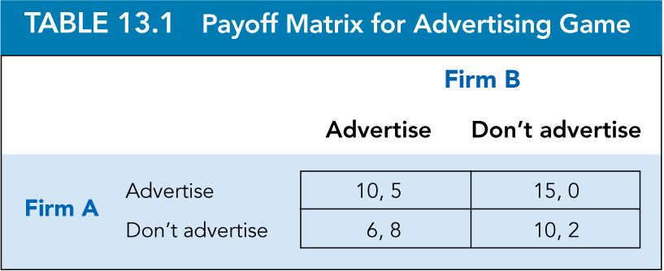
Dominant strategy
Dominant strategy : Strategy that is optimal no matter what an opponent does.
Eg: Suppose Firms A and B sell competing products and are deciding whether to undertake advertising campaigns. Each firm will be affected by its competitor’s decision.

Slide 36
GAME THEORY
Equilibrium in dominant strategies : Outcome of a game in which each firm is doing the best it can regardless of what its competitors are doing
Dominant Strategies: I’m doing the best I can no matter what you do. You’re doing the best you can no matter what I do.
Nash Equilibrium: I’m doing the best I can given what you are doing. You’re doing the best you can given what I am doing.

Slide 37
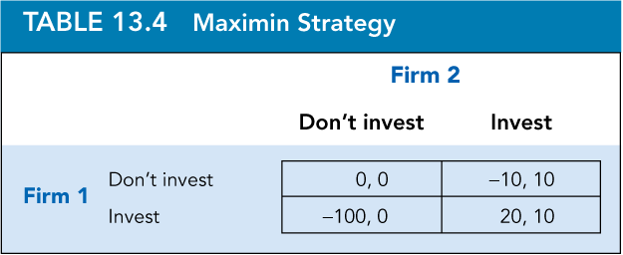
MAXIMIN STRATEGY
The concept of a Nash equilibrium relies heavily on individual rationality. Each player’s choice of strategy depends not only on its own rationality, but also on the rationality of its opponent. This can be a limitation.
Maximin strategy: Strategy that maximizes the minimum gain that can be earned.
If Firm 1 is unsure about what Firm 2 will do but can assign probabilities to each feasible action for Firm 2, it could instead use a strategy that maximizes its expected payoff.

Slide 38
Pricing Strategies

Slide 39
Average Cost Pricing
Refers to the simplest method of determining the price of a product. In cost-plus pricing method, a fixed percentage, also called mark-up percentage, of the total cost (as a profit) is added to the total cost to set the price.
For example, an organization bears the total cost of Rs. 100 per unit for producing a product. It adds Rs. 50 per unit to the price of product as’ profit. In such a case, the final price of a product of the organization would be Rs. 150.
Is also known as Cost-plus pricing. This is the most commonly used method in manufacturing organizations.

Slide 40
MARGINAL COST PRICING
In marginal cost pricing, the benchmark cost for each outcome is the cost required to produce it. This cost does not include fixed costs of the business, such as rent payments, which do not vary with the level of production.
Marginal cost is only the cost of the labor, material and other direct inputs for producing each item.
Under marginal cost pricing, the business would first decide how much to produce and then set its price based on the marginal cost of the last unit it produces.

Slide 41
Full-Cost Pricing
Full-cost pricing seeks to include every cost of running a business in the cost of producing goods. These costs include rent, a fixed cost or initial outlays of money for purchasing and renovating a location, which is a sunk cost.
The pricing manager attributes total costs of the business equally to each item produced for sale. Full costs are higher than marginal costs, because they include more than just the variable costs associated with production.

